Slide 1




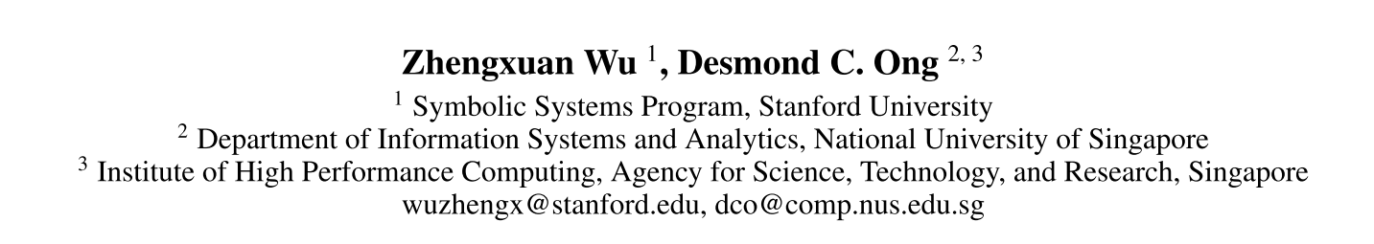





Chongqing University of Technology
ATAI
Advanced Technique of Artificial Intelligence
Chongqing University of Technology
Context-Guided BERT for Targeted Aspect-Based Sentiment Analysis（AAAI 2021 ）
彭展望
https://github.com/frankaging/Quasi-Attention-ABSA

Slide 2
Outline
Introduction
Related Work
Method
Experiment
Conclusion

Slide 3
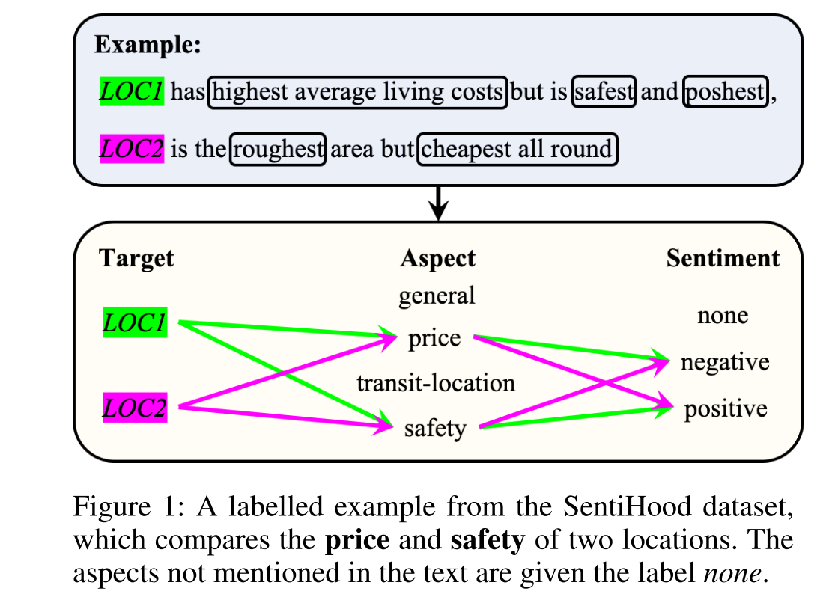
Introduction

Slide 4
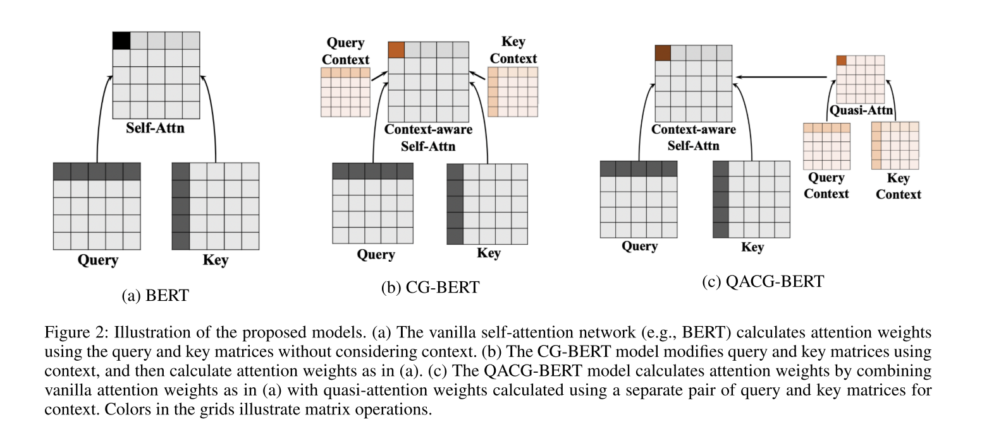
Method

Slide 5
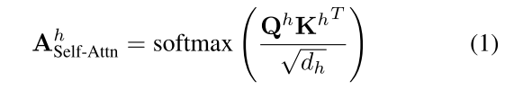
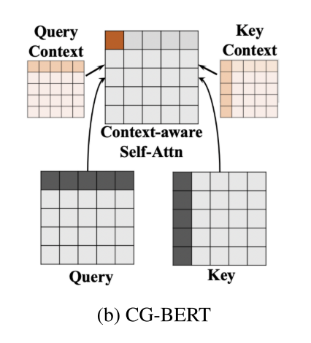








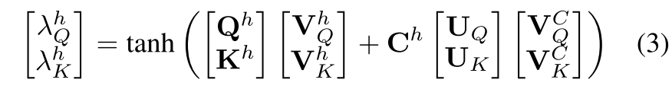

Context-Aware Self-Attention Networks(AAAI 2019)

Slide 6
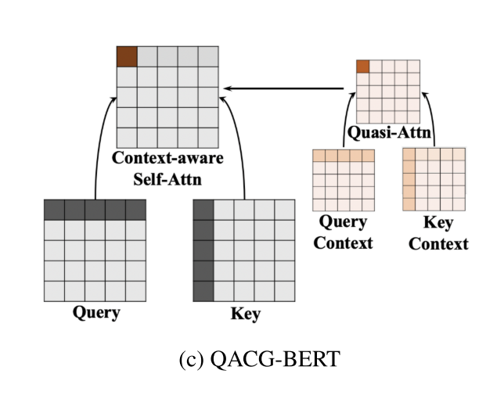
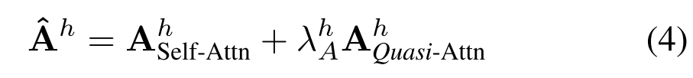
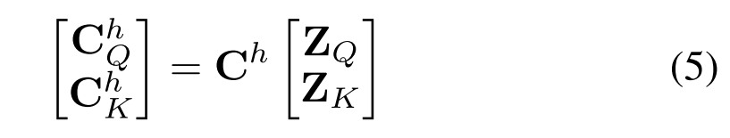

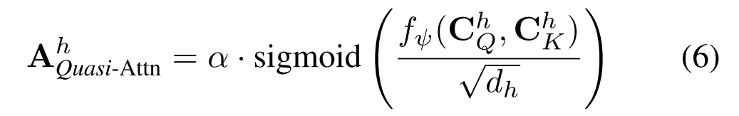

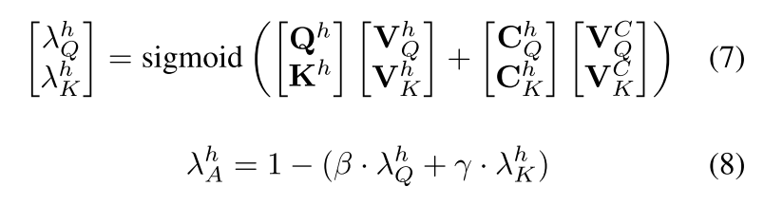


Compositional De-Attention Networks (NeurIPS 2019)
$$α=1$$
Notes:
$$α=1$$

Slide 7






Slide 8
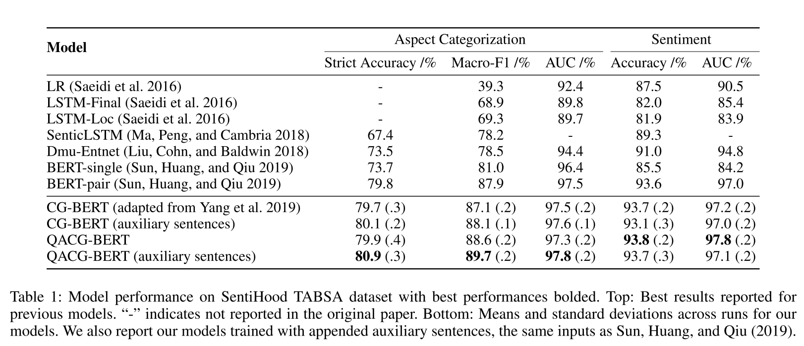

Experiment

Slide 9
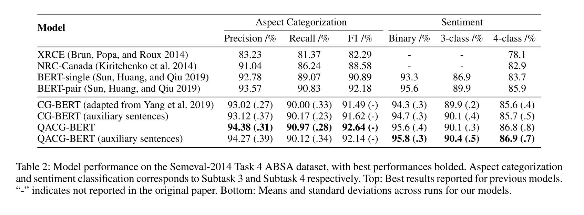
Experiment

Slide 10
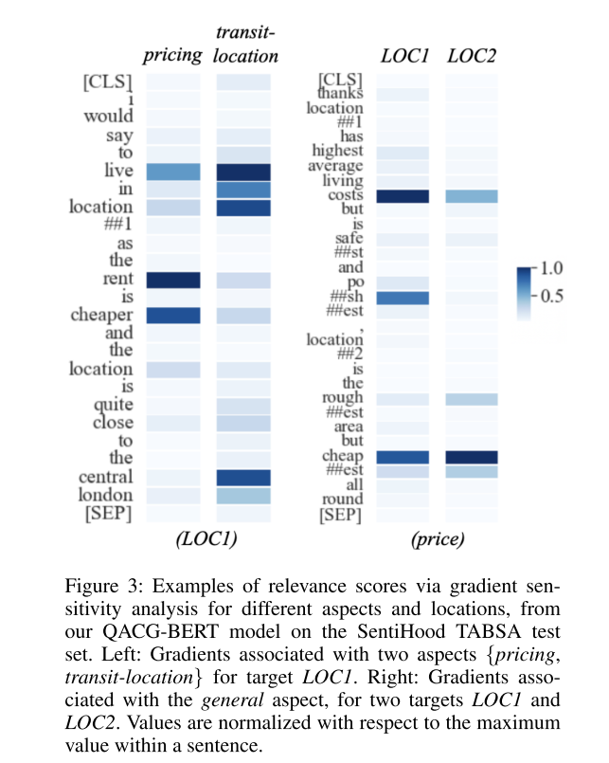
Experiment

Slide 11
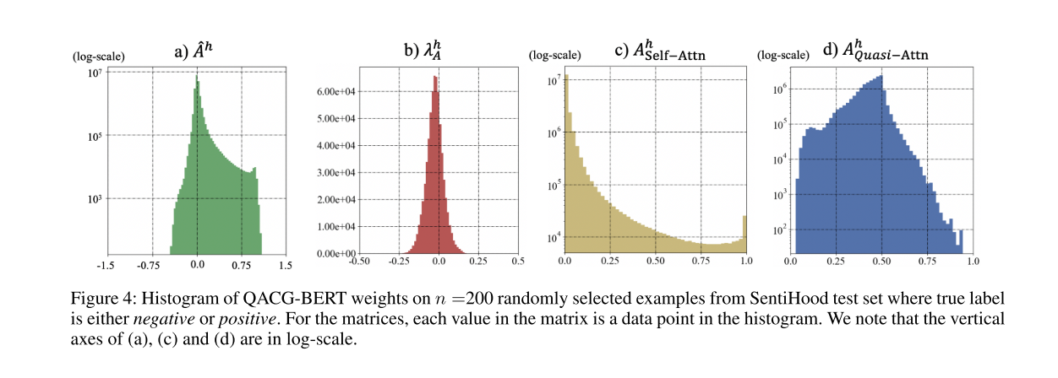

Experiment

Slide 12
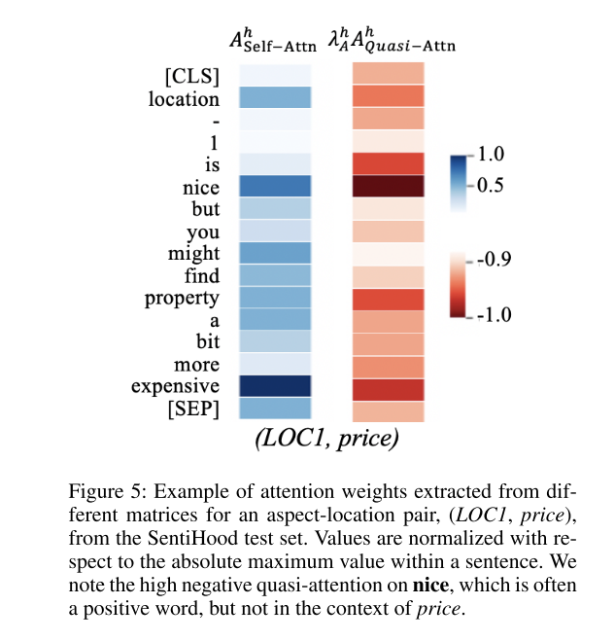
Experiment

Slide 13
Thanks

